Slide 1

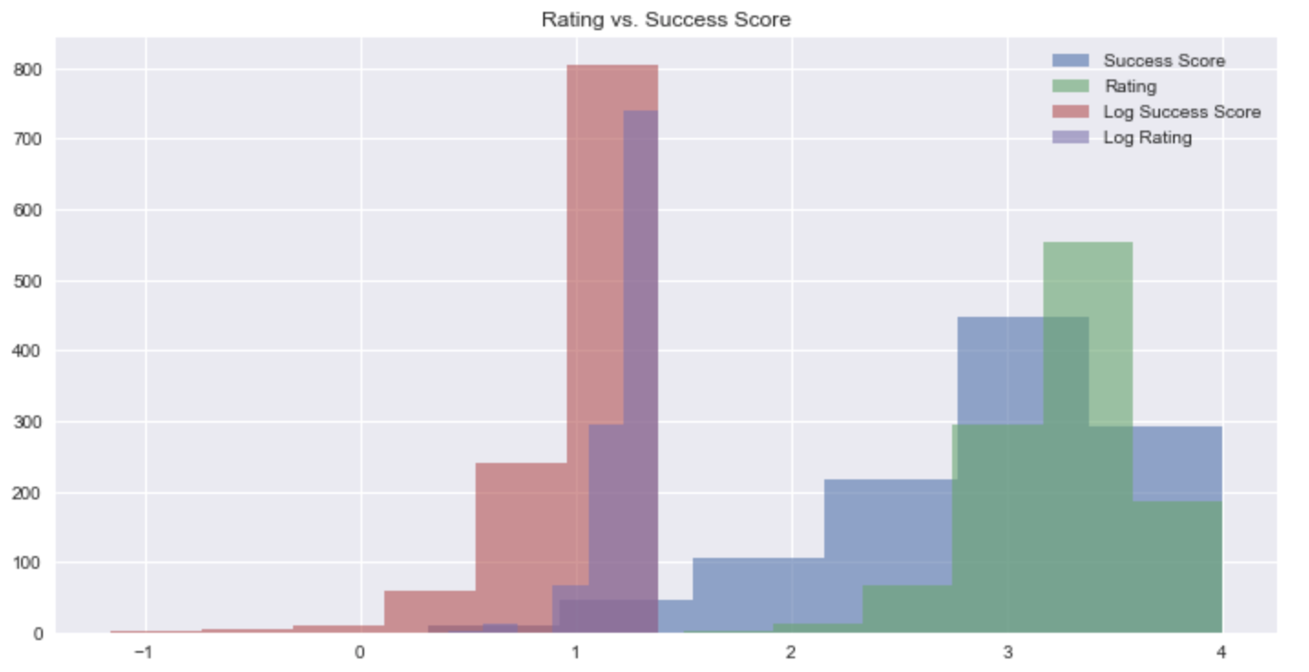
Predicting the Success of a Recipe
Success Score = Rating * ”Make it again”
Choosing the Dependent Variable

Slide 2
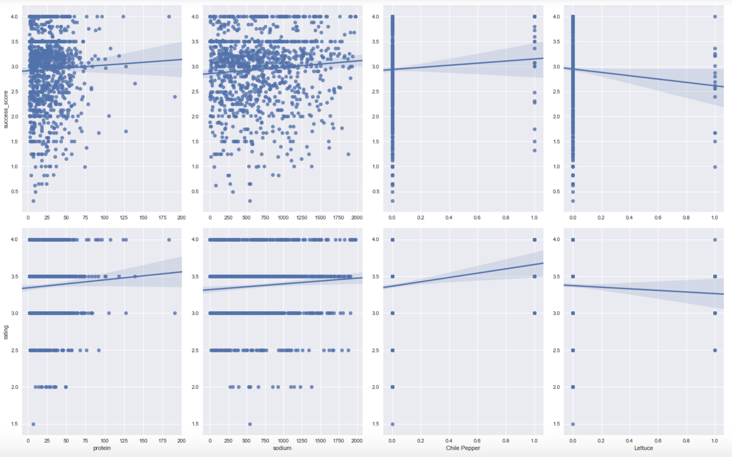
Success Score
Rating

Slide 3
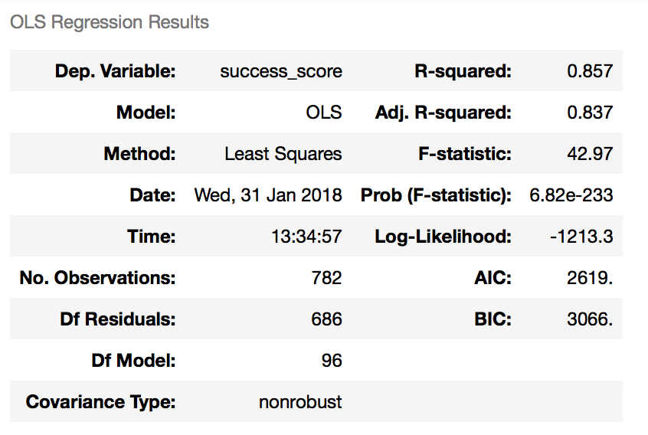
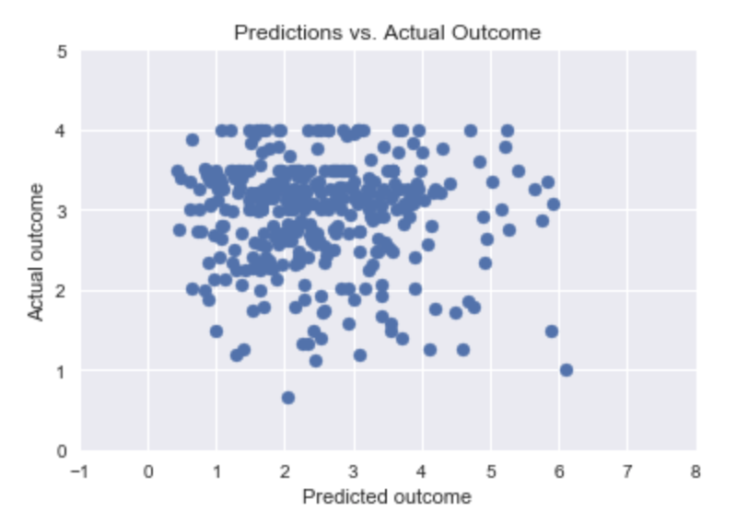

MSE = 1.99

